Slide 1
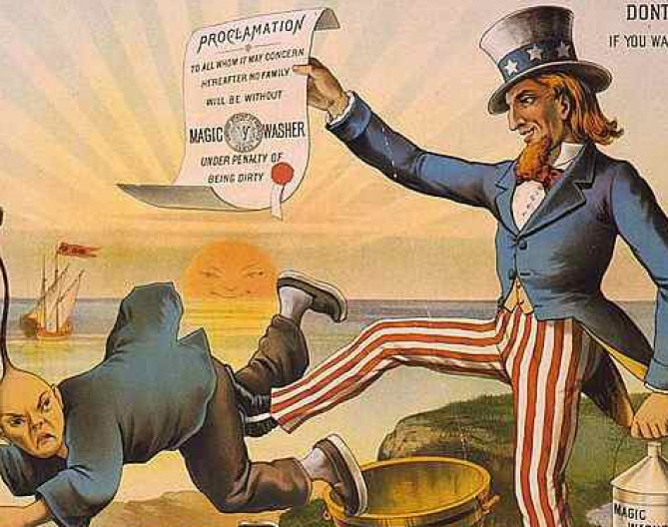
Week 2 Monday
Logistics:
Sign in before or after lecture on section color. [Section 301 meets at W 1:05].
my office hours have changed to:
Monday after lecture; Wed. at 2:30.
Every week: first or last slide announces upcoming reading taken from syllabus
Today: On the exam structure and notetaking
Today’s focus: “Legacies of Discrimination,” Ancheta;
“Persistence of Yellow Peril Discourse,” Ono and Pham
“How ‘Crazy Rich’ Asians Have Led to the Largest Income Gap in the U.S.,” Hassan and Carlsen

Slide 2
Sections
Check your section assignment
Make note of your color assignment for Monday’s lecture sign-in
Leslie (W after this lecture at 1:05) 301: clouds
Mojca: sections TR and F:
302 grey; 306 light blue; 307 green; 310 lavender
Nabiha: sections TR and F
303 red; 304 yellow; 308 orange; 309 pink

Slide 3

EXTRA Participation credit: Vietnamese American Memoir Reading and Discussion: Beth Nguyen aka Bich Minh Nguyen on her new book
Thursday, September 14
6:00pm
A Room of One's Own, Free
2717 Atwood Ave, Madison

Slide 4
Today:
If “Asia” is the world’s most populous region, why are Asian Americans only 5.6 % of the US population?
--Racialization tied to structural discrimination, here the law (Ancheta)
Focus on two forms of anti-Asian laws affecting Asian populations in the U.S.
A. naturalization laws (who gets citizenship)
B. immigration laws (who is allowed to migrate)
--Link these laws to 2 dominant beliefs surrounding Asians and Asian Americans
First, the “Yellow Peril” stereotype (Ono and Pham)

Slide 5

and --an exercise linking the impact of the laws to our class demographics and how it contributes to differences among Asian ethnic groups in the U.S.

Slide 6
From Ancheta, “Legacies of Discrimination,” p. 22
Anti-Asian laws came in three forms:
“federal naturalization laws that imposed a racial barrier on Asian immigrants seeking United States citizenship;
(2) federal immigration laws limiting migration from Asia and Pacific Island countries; and
(3) state and local laws discriminating against Asians, often based on their ineligibility for citizenship.”

Slide 7
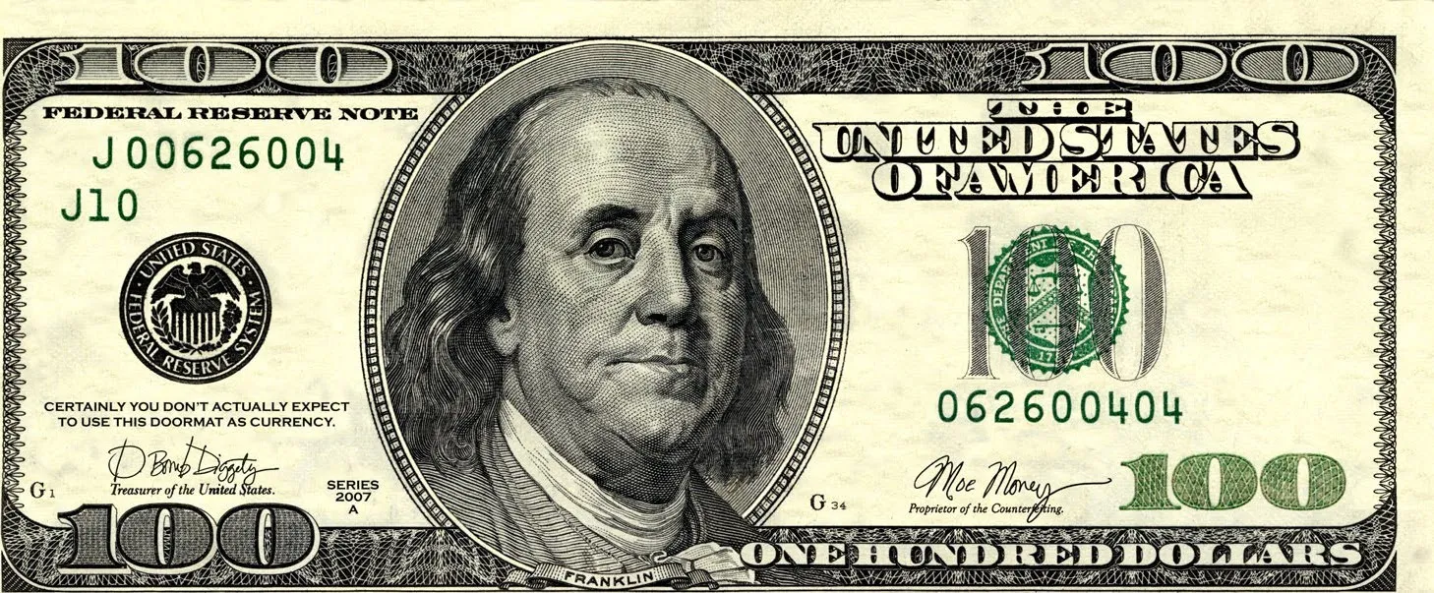
Race and citizenship: 1790 Naturalization Act
“Why should we darken the people of America? “Why increase the Sons of Africa, by Planting them in America, where we have so fair an opportunity, by excluding all Blacks and Tawneys, of increasing the lovely White?”
Ben Franklin, 1751
“Providence [had] been pleased to give this one connected country to one united people—a people descended from the same ancestors, speaking the same language, professing the same religion, attached to the same principles of government, very similar in their manners and customs.”
John Jay, Federalist papers, 1788

Slide 8
1. Naturalized Citizenship (the ability to apply for citizenship) as racialized
Contestations to the 1790 Naturalization Law exclusions:
--Ozawa v. United States, 1922
--United States v. Thind, 1923
End to federal naturalization laws restricting immigrants from seeking U. S. citizenship:
McCarran-Walter Act of 1952 [Immigration and Nationality Act]

Slide 9
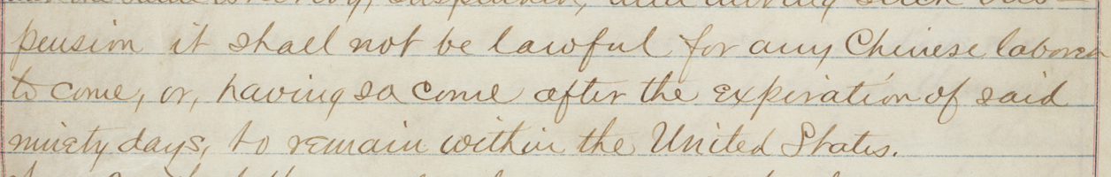
text of Chinese Exclusion Act, 1882: “it shall not be lawful for any Chinese laborer to come, or having come after the expiration of said ninety days, to remain within the United States.”
From Ancheta:
2. Anti-Asian Immigration Laws:
Asian exclusions aimed at limiting immigration by race and region
1875 Page Law
1882 Chinese Exclusion Act

Slide 10
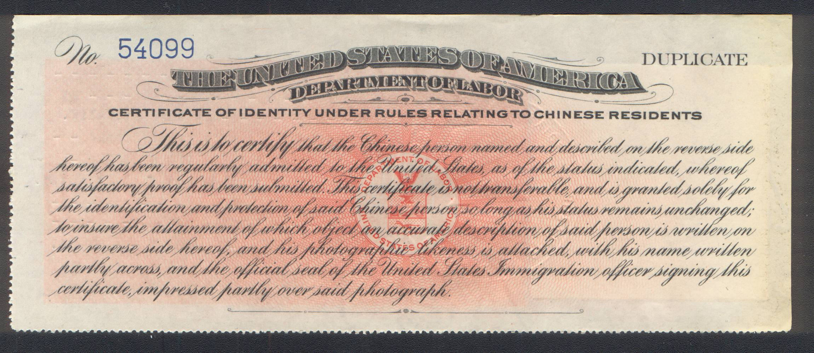
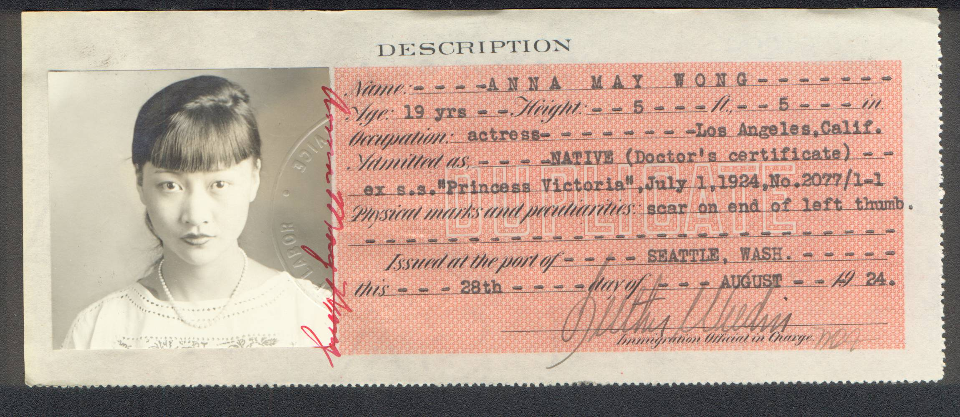
Certificate of Identity required by Chinese/
Chinese Americans during the exclusion era, 1882

Slide 11
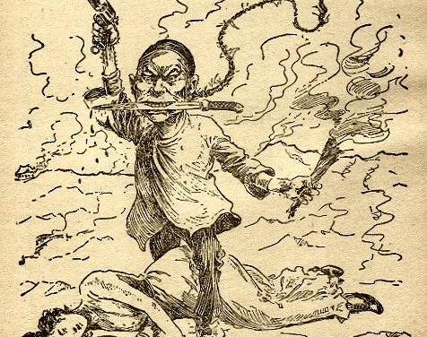
“The Persistence of Yellow Peril Discourse” Ono and Pham
“By yellow peril, we mean representations of Asians and Asian Americans as threatening to take over, invade, or otherwise negatively Asianize the US nation and its society and culture” (25).

Slide 12
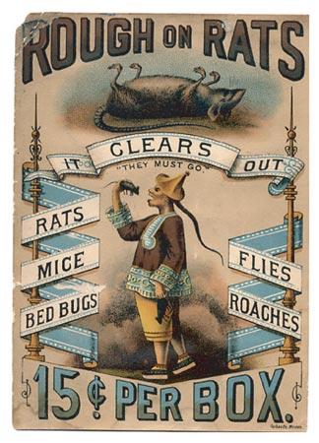
Gina Marchetti on the Yellow Peril, cited in Ono and Phan, p. 28:
“Rooted in medieval fears of Genghis Khan and Mongolian invasions of Europe,
the yellow peril combines racist terror of alien cultures,
sexual anxieties,
and the belief that the West will be overpowered and enveloped by the irresistible, dark, occult forces of the East.”

Slide 13
Yellow Peril discourse focused on cultural difference, threats to:
--spirituality and religion (as heathen)
--sexuality (as a threat to white women)
--public health (as diseased)

Slide 14
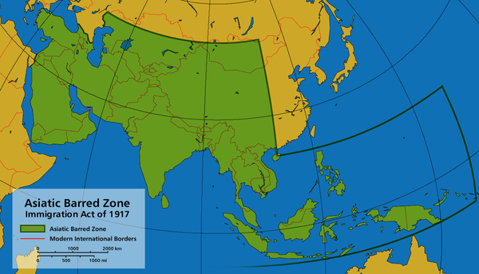
On the reach of anti-Asian U.S. immigration policy after 1880 (in green):
“Nearly all subsequent immigration legislation regarding Asians in the pre-World War II period either iterated or extended the racial exclusions first inflicted on the Chinese . . . .
The Gentleman’s Agreement of 1907-1908 cast Japanese and Koreans into this exclusionary net,
and the 1917 Immigration Act* denied entry to Asian Indians. . . .
The Tydings-McDuffie Act in 1934 added Filipinos to the list of excludables.”
Paul Ong and John M. Liu,
“Immigration Policies and Asian Migration”
*Created an “Asiatic barred zone”
including Southeast Asia,
the Pacific Islands, and Middle East

Slide 15
Ancheta, p. 19: Why was 1965 a “watershed” moment for Asians in the history of U.S. immigration law?
Immigration Act of 1965
removed “explicit racial and national origin categories from the law” (Ancheta, p. 37)
and reopened immigration from Asia
[quota of 20,000 for each country]

Slide 16
Linking the impact of the laws to our class demographics
Continue standing if you or your family migrated to the U.S. from Asia or the Pacific Rim (Asian Americans or Asians in U.S.). International students from Asia should also stand.
Sit down if you or your family came to the U.S. AFTER 1965.
On the basis of reading Ancheta or your knowledge of history, why the difference?

Slide 17
For Wed.:
Read:
“Symbolic Capital and Stereotype Promise,” Lee and Zhou
and
View Media:
“A Conversation with Asian-Americans on Race,” Gandbhir and Stephenson

